Slide 1
AI sommelier

Slide 2
Today’s presentation:
Introduction
Vision: Ingredient detection
NLP, NER: Food and Wine pairing
Text generation: Sommelier text
Web Application
Q&A

Slide 3
Introduction

Slide 4
Concept
A cooking app with the following features
Detecting different types of food in your fridge
Give a recipe with the detected food
Pair the recipe with a wine
Generate a description of the wine

Slide 5
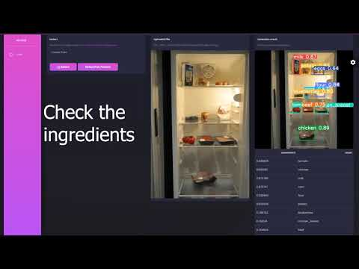
Demo

Slide 6
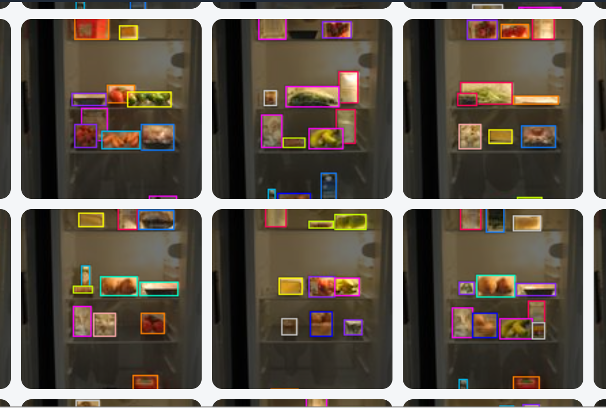
Vision - ingredient detection

Slide 7
Data
fridge pictures
not publicly available (fridgenet) or not suitable (CMU10_3D)
general purpose not suitable (imagenet, coco)
=> own creation

Slide 8
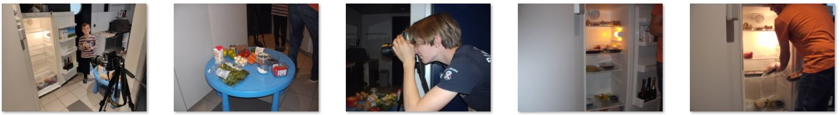
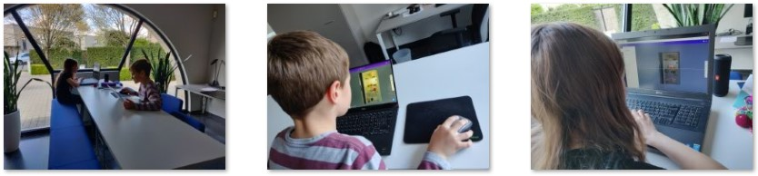
DIY fridge images
We created our own images (516 images)
1 fridge with a fixed camera position (1424-2144px - iso 400 - 300dpi -sRGB)
30 ingredients selected from top50 ingredients in recipes
We manually annotated with square bounding boxes
www.roboflow.com as platform
labeled ½ of the images to create a 'helper model'
used this 'helper model' as label-assist on the second half
divided the work in our group and had some extra aid ..

Slide 9
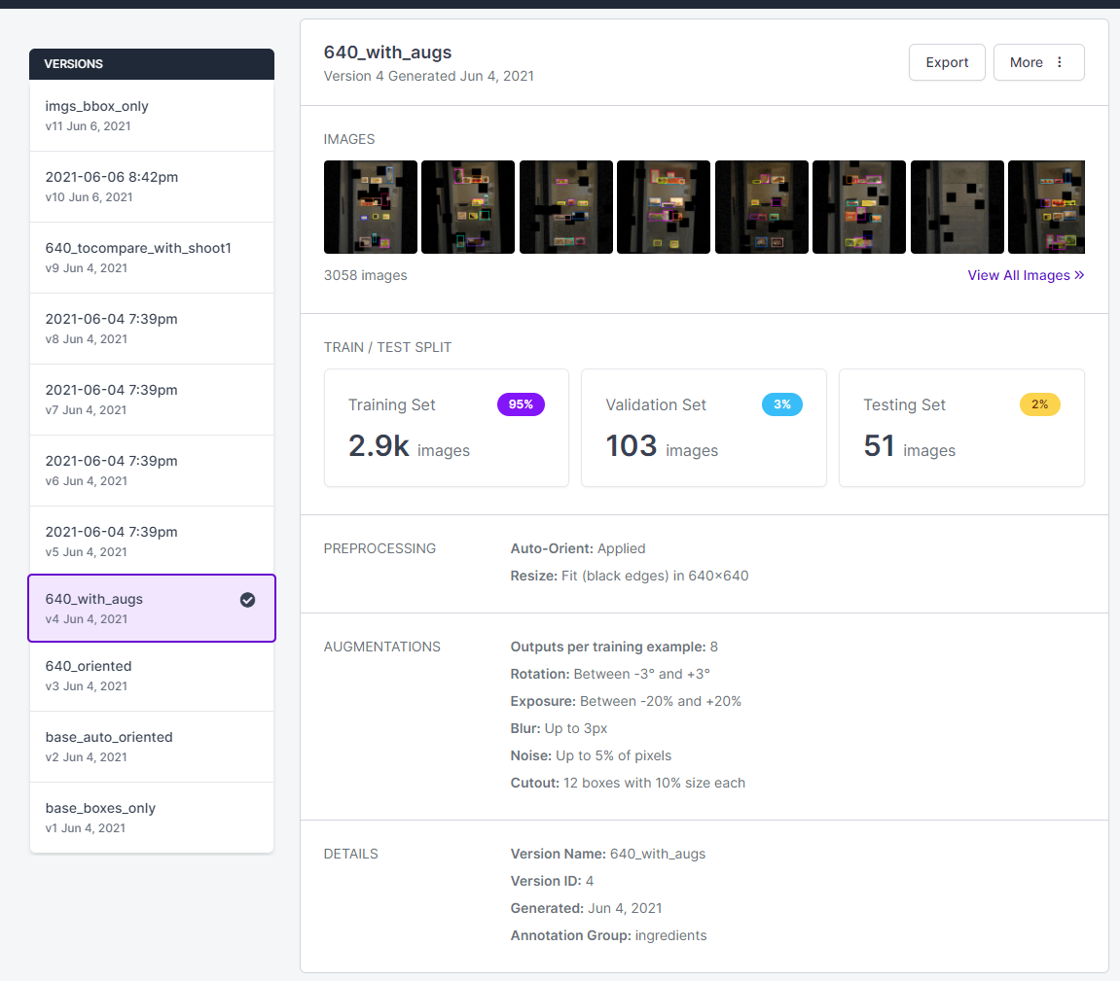
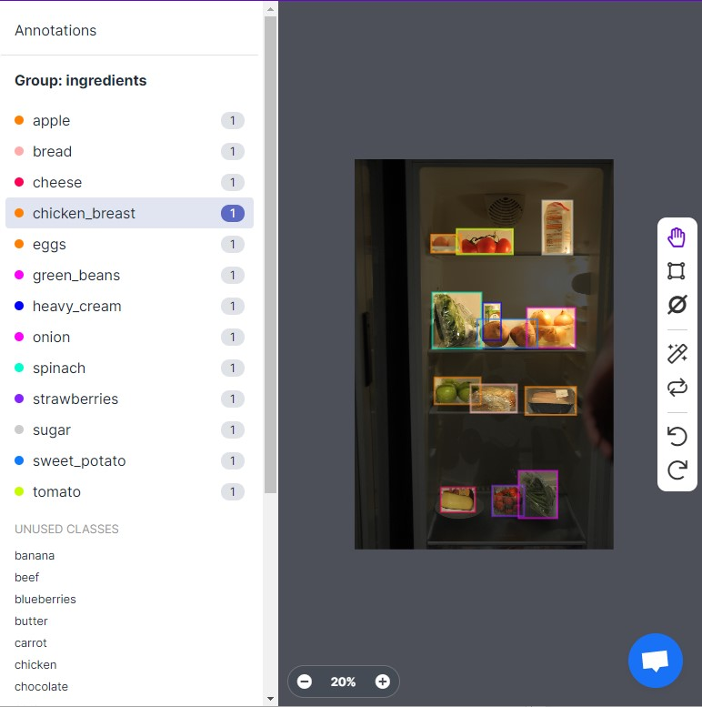
DIY fridge images
https://public.roboflow.com/object-detection/aicook
Dataset versions used during exploration and development, not for final solution
applying labels

Slide 10
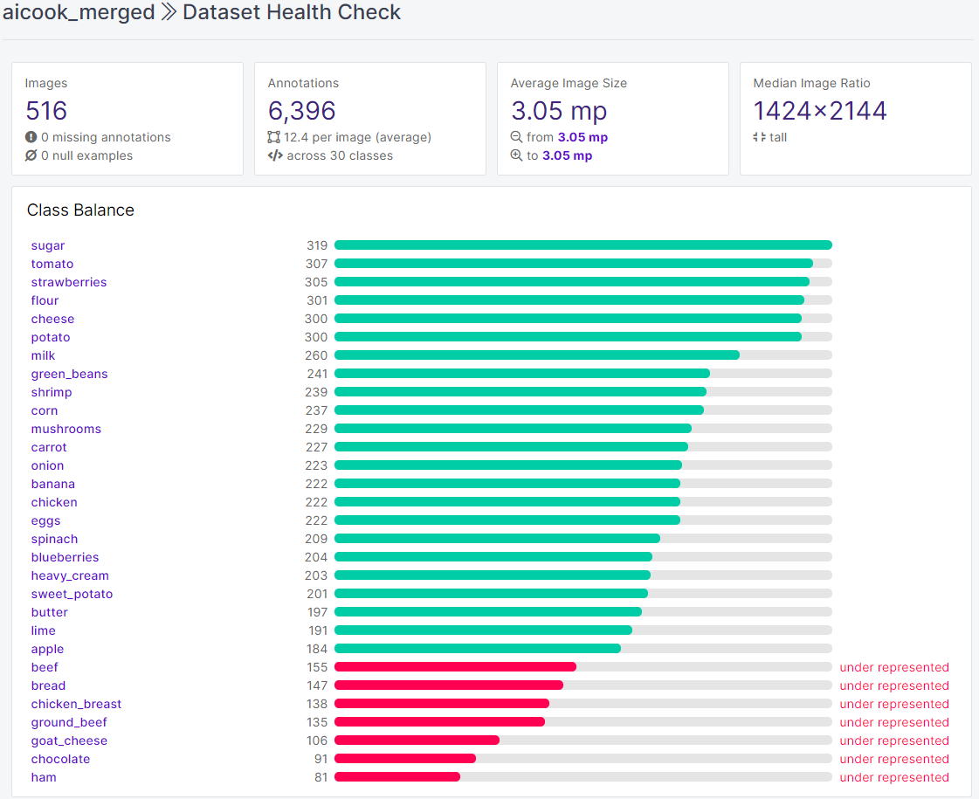
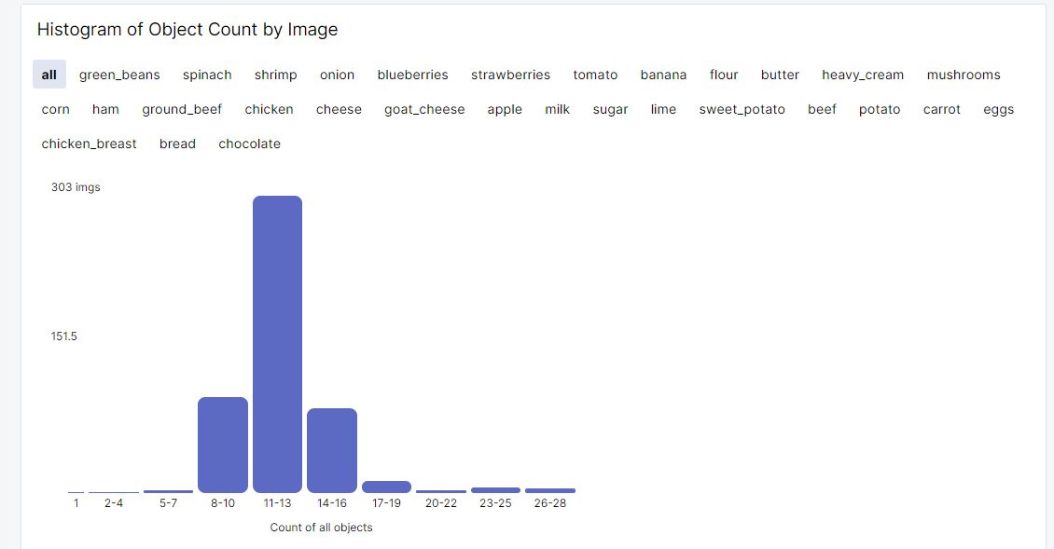
DIY fridge images
Roboflow

Slide 11
Model: YOLOv5
YOLOv5 (https://github.com/ultralytics/yolov5)
multilabel (30) classification
loss: binary cross entropy
easy to use
small training set (pretrained)
fast training ( = lower GPU resource)
detection + classification in one pass
adaptable structure / various versions (s,m,l,xl - 6)
integrated monitoring (wandb)
No comparison with other models
resnetV50, InceptionV3, VVG16/19, ...

Slide 12
Ingredient detection
Model definition and selection (notebook)
git clone and install YOLOv5
pull data: images and bboxes from roboflow
image transformation & augmentation
train and evaluate
colab, kaggle, azure GPU
wandb
identify the most suitable (best) version
Inference time (py module)
upload the best weights from training
torch hub load YOLOv5
resize image before inferencing
display results
confidences (> 60%)
image with bounding boxes

Slide 13
Ingredient detection
Image Transformation
YOLOv5 needs square images (*32)
640 with black padding
needed for training, validation and preferably testing
& Augmentation
more train images 349 => 5.584 (configurable)
improve model generalization, avoid overfitting
Tackle environment diversity
cutout to simulate overlap/occlusion
exposure to simulate different lighting conditions
Tackle camera diversity
rotation, noise and blur (also lighting)
incl Bounding Boxes
format conversion YOLO <-> VOC

Slide 14
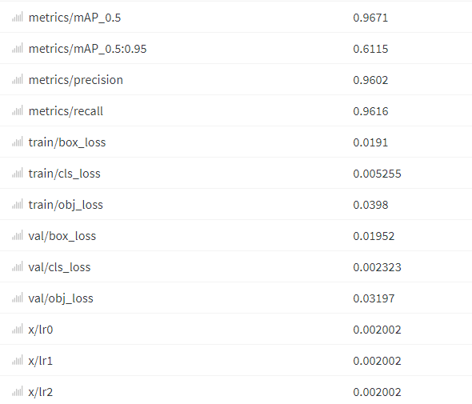
Ingredient detection
Training and evaluation
wandb (36 runs kept)
architecture
backbone - neck - head
s-m-l-xl - 6 => s6
pretrained ? => yes!
augmention ? => yes! yes!
parameter evolution
batch-size => 16, 24, 32 => no real difference, 16
optimiser: adam/SGD => adam
evolve
for the internal parameters skipped; too much GPU time needed ...
Notes:
backbone: CNN => image features representations in various formats (leaky relu)
neck => combinate the image features
head => classify, objectity, box predictions

Slide 15
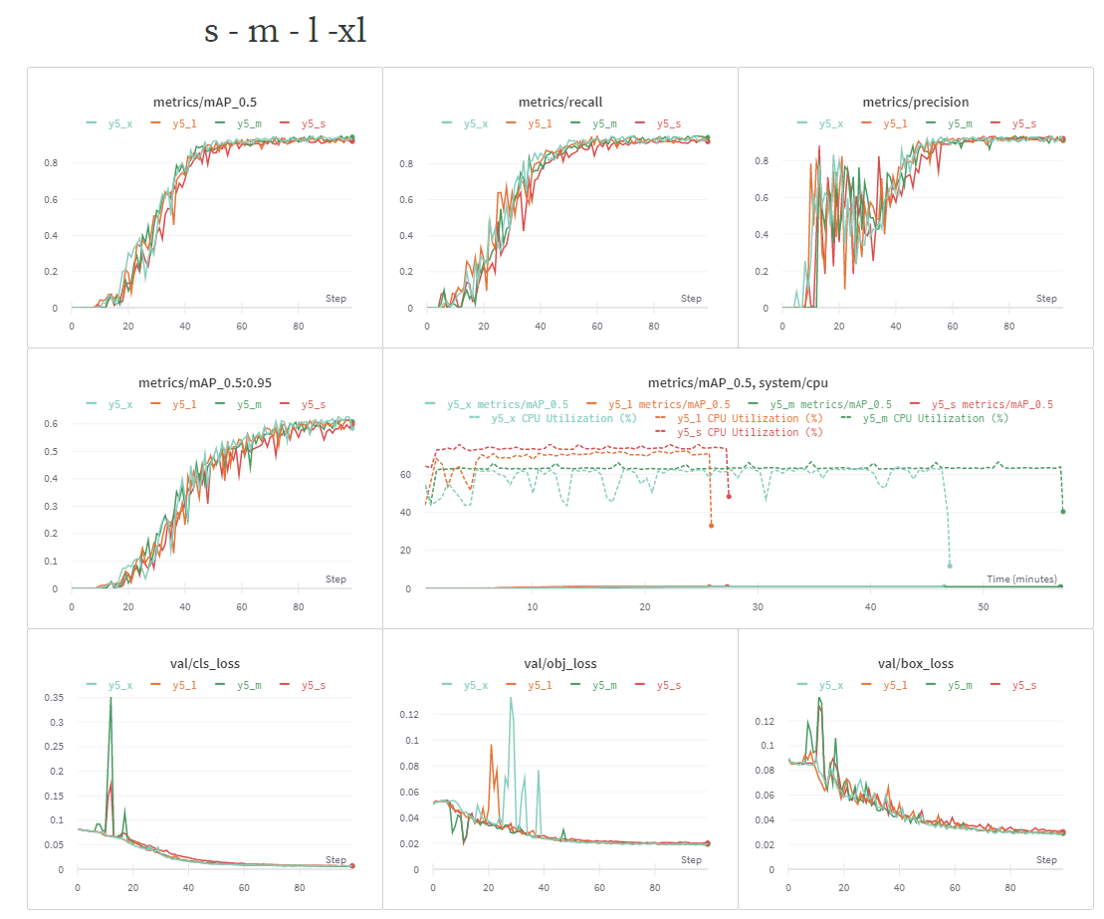
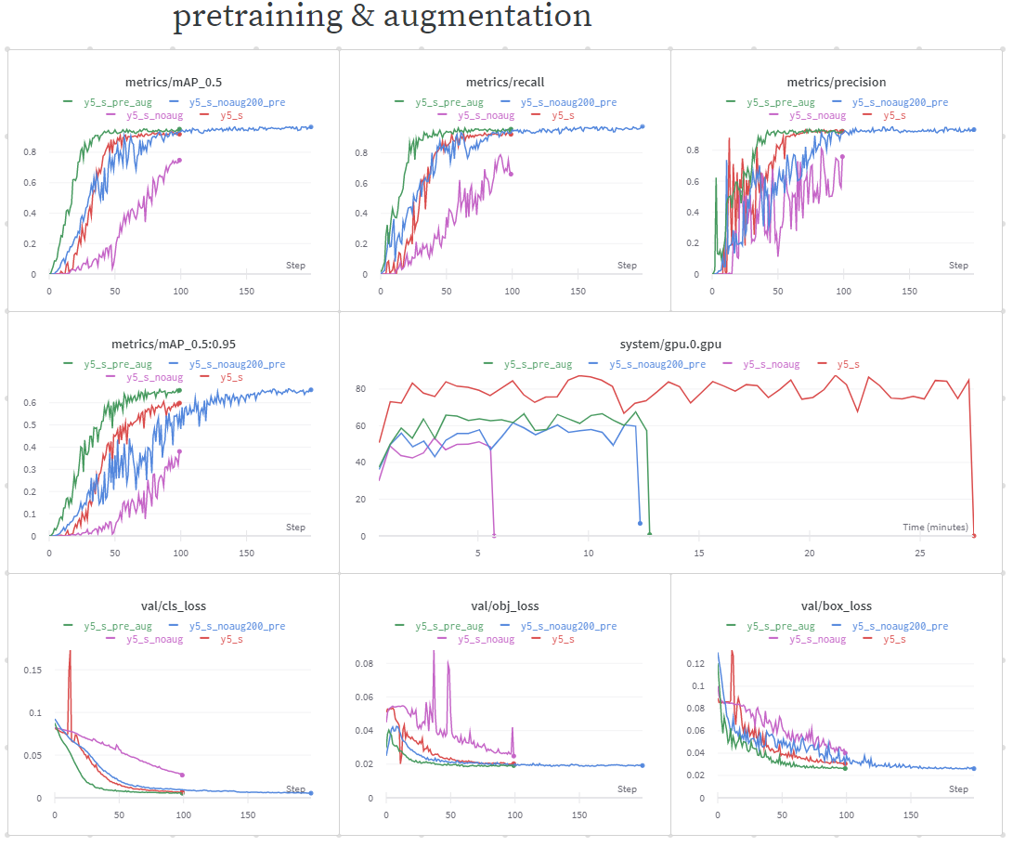
Ingredient detection
https://wandb.ai/cornelka/aicook_yolo5
Notes:
sml xl: almost the same; gpu resources; higher risk on overfitting with larger models => S
pretraining and augmentation are key: precision is most stable (other setups seem unfit, or might need lots of epochs to train) (atypical resource consumption y5_s)

Slide 16
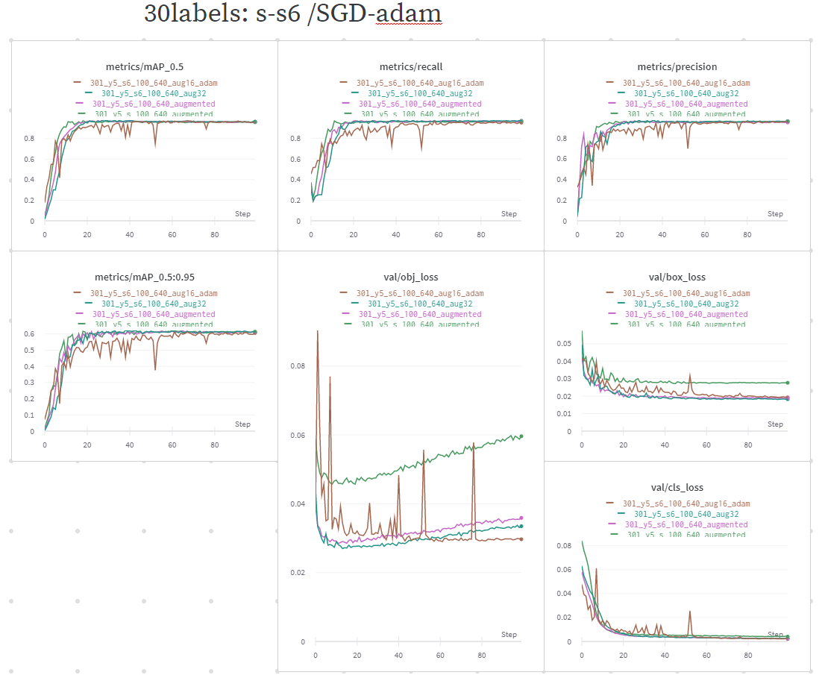
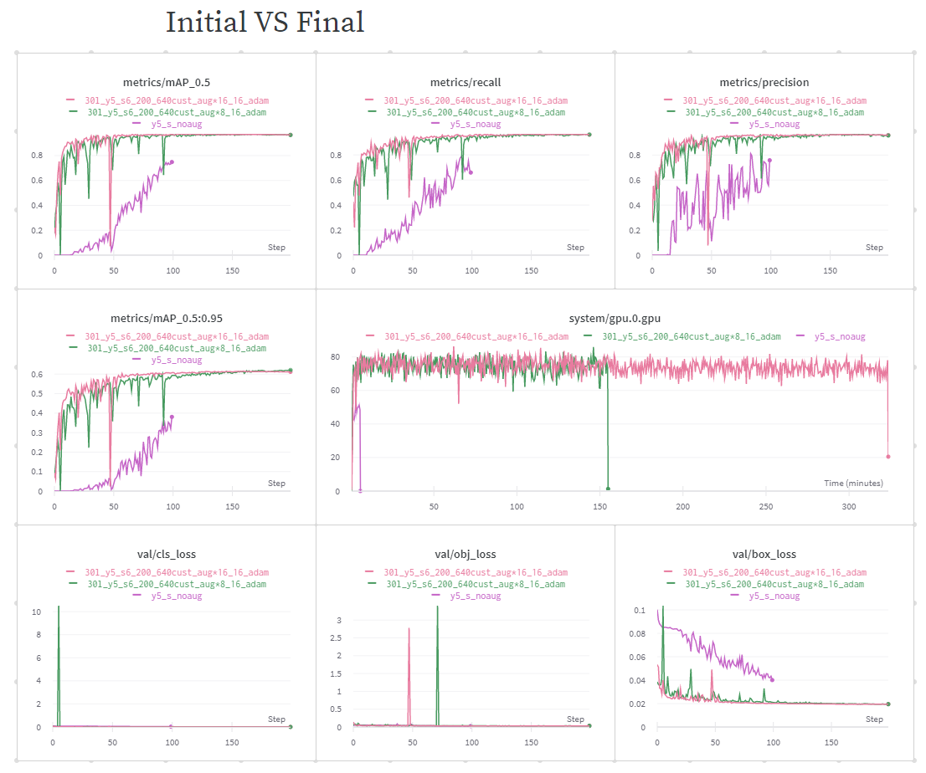
Ingredient detection
https://wandb.ai/cornelka/aicook_yolo5
Notes:
obj-loss goes up when using SGD => adam solves this, but makes model less rigid (tuned batchsize, epochs, learning rate could have been adjusted as well)

Slide 17
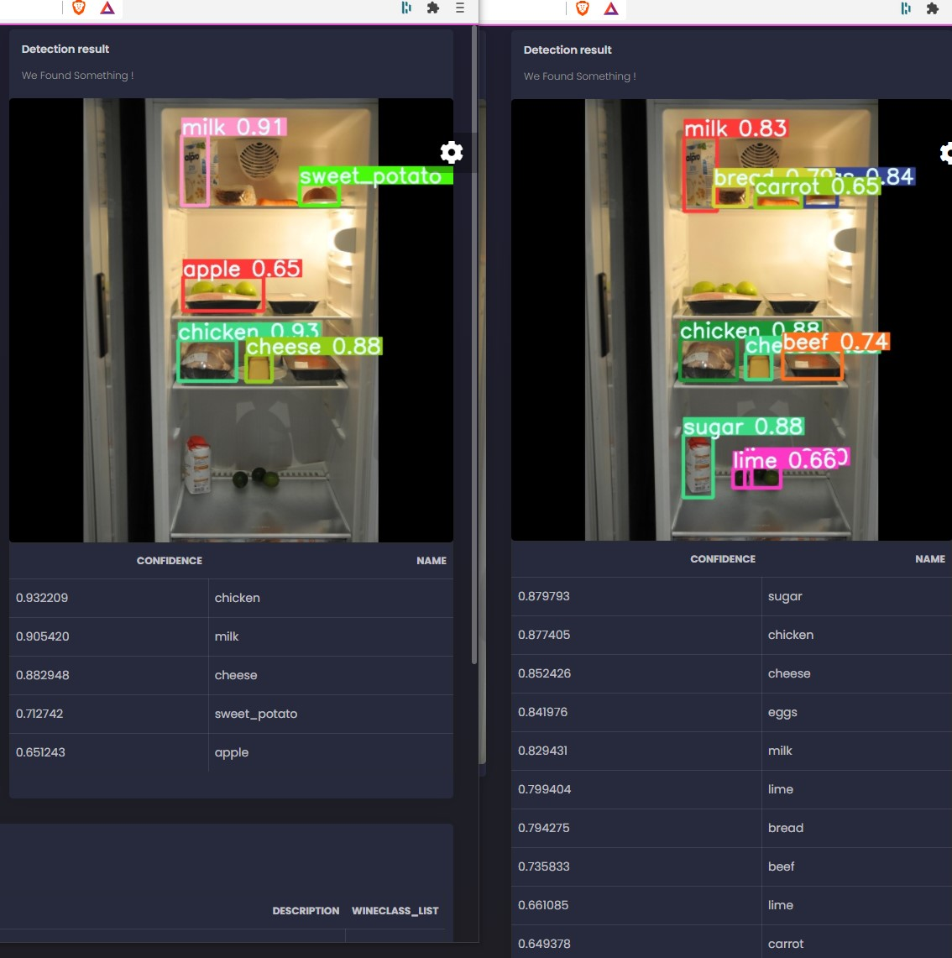
Ingredient detection
Initial vs Final (+60% confidence)
Final model details
https://wandb.ai/cornelka/aicook_yolo5/runs/7icejy0h?workspace=user-cornelka
Notes:
more detections, higher confidences

Slide 18
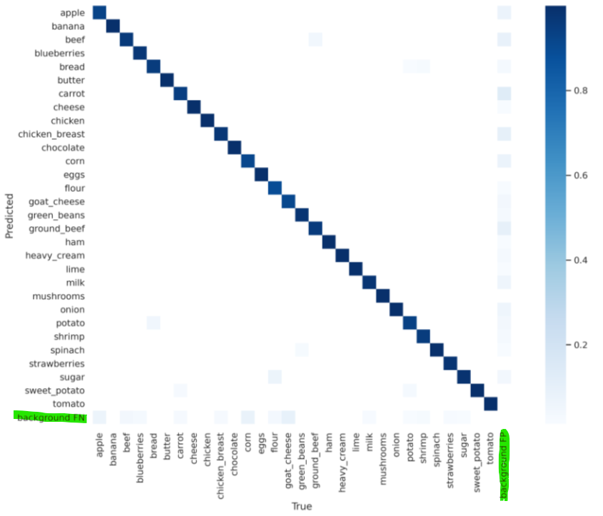
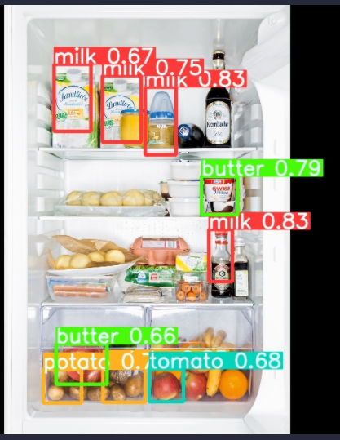
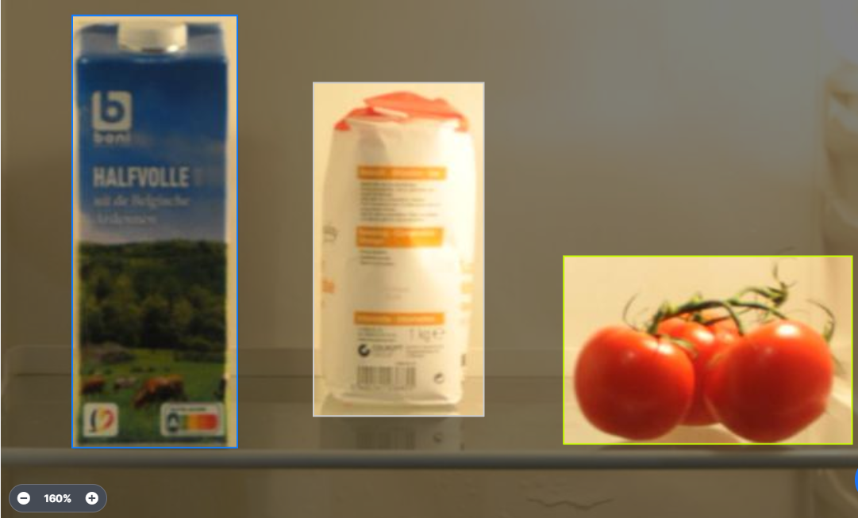
Critical notes
strongly reduced context; not real-life
drop between mAP_0.5 (0,97) and mAP_0.5:0.95 (0.61) results
due to “poor” ground truth bounding box quality ! (margins + objectgroups)
model overfitted, but still background issues in classifications
BBOX quality + in our context segment before detect
Notes:
DROP:
due to too invasive augmentations (cut-outs) ?!?
too few input images
no real hyper-parameter tuning

Slide 19
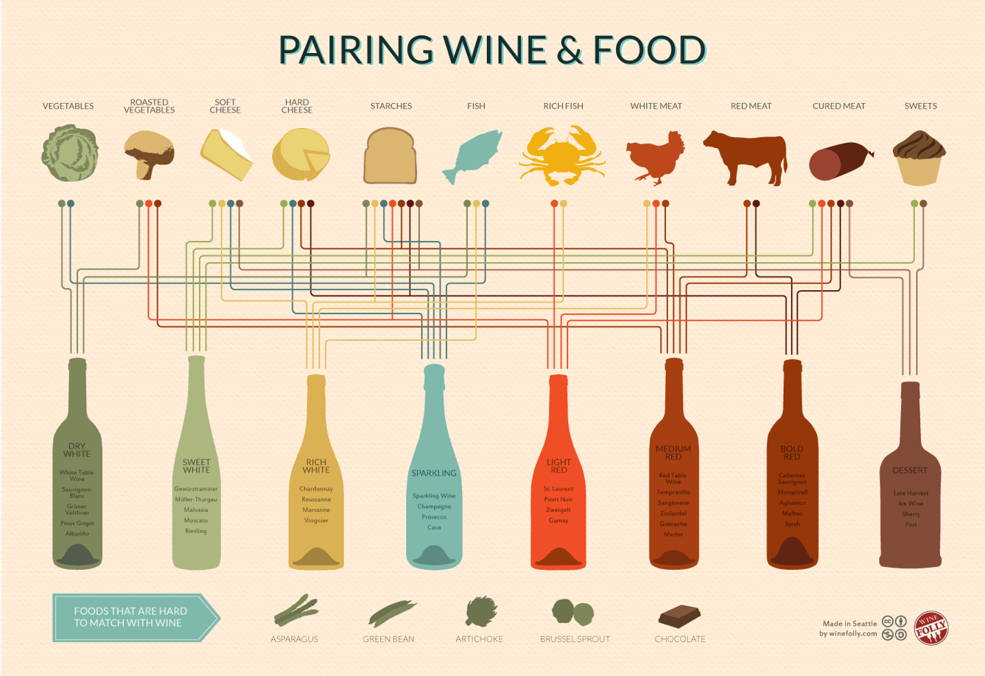
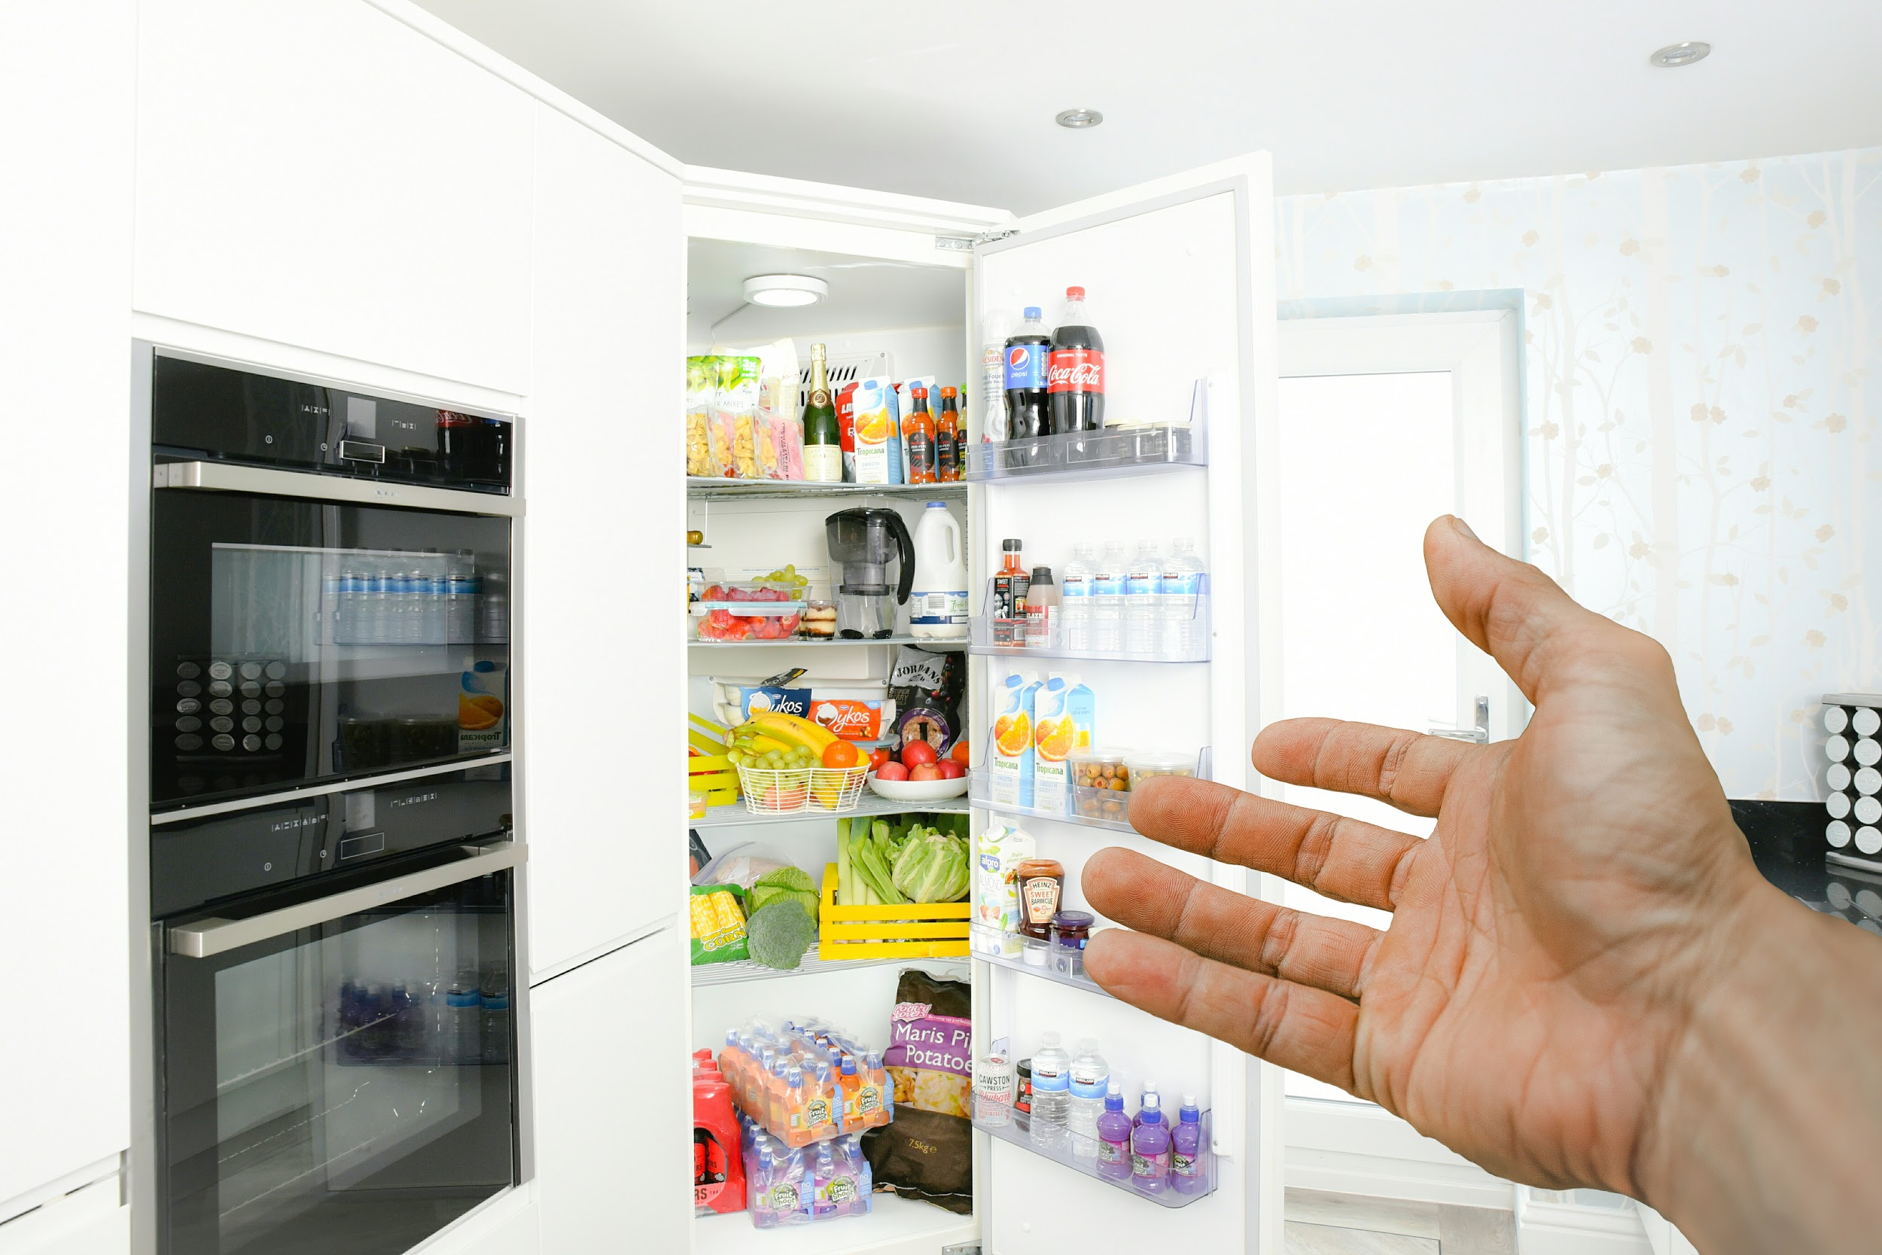
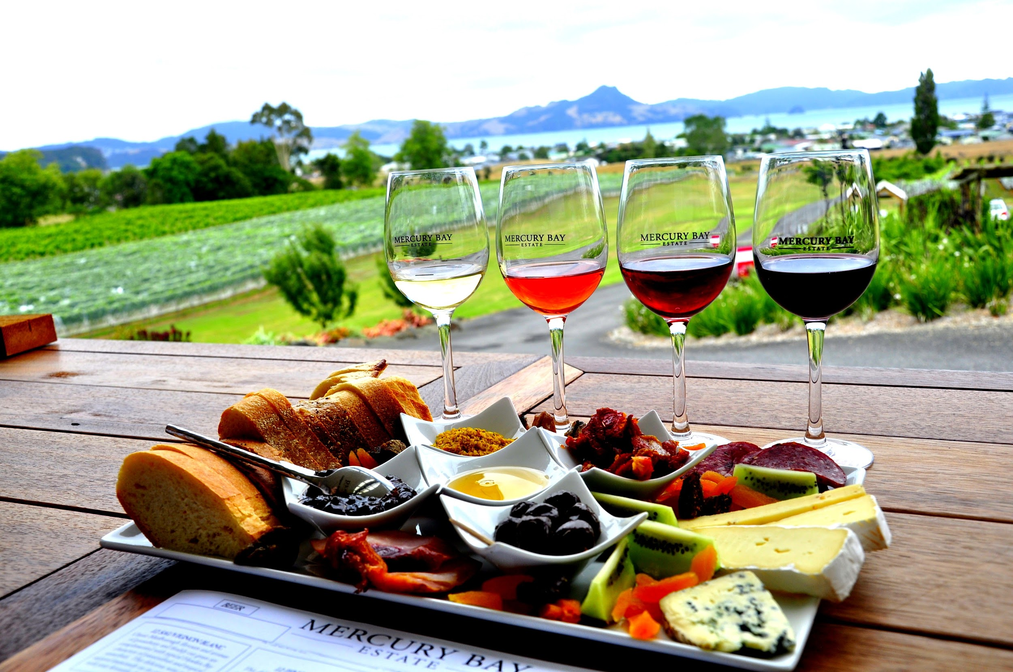
NLP, NER: Food and Wine pairing

Slide 20
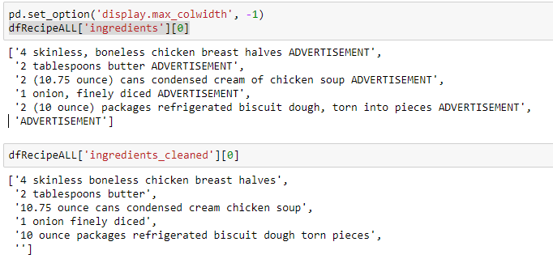
Pairing
Cleaning ingredients
comma’s
unwanted words
brackets

Slide 21
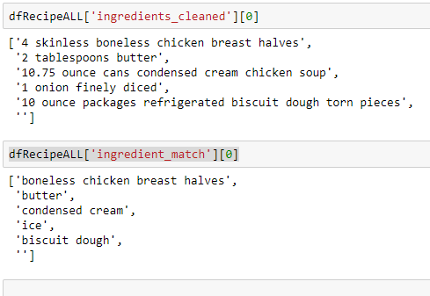
Pairing
Crosscheck with own list of ingredients

Slide 22
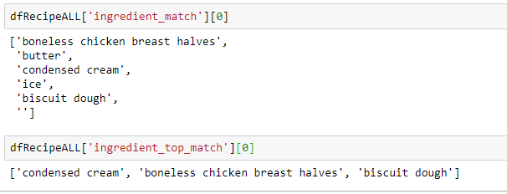
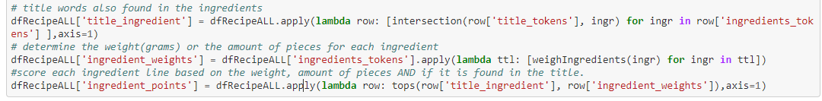
Pairing
Get most important ingredients based on own point calculation

Slide 23
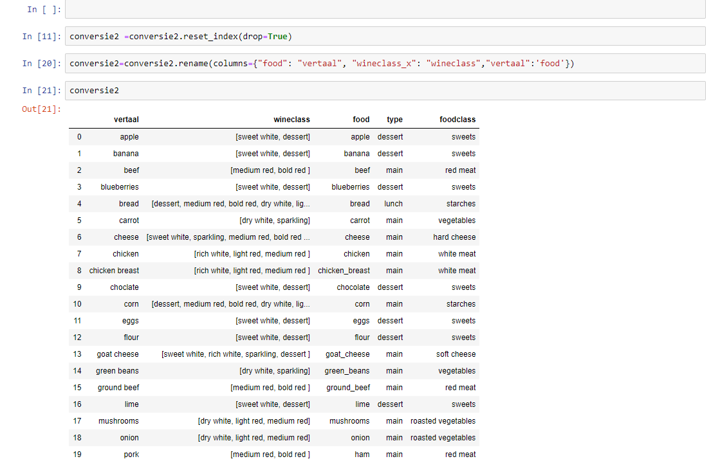
Pairing
Create file to add info to input
foodclass
translation
wineclass

Slide 24
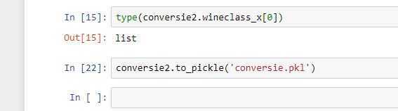
Pairing
Both ingredients and wineclass must be list
Save as pickle to keep structure

Slide 25
Pairing
iterate over recipes
get all matches
give 1 sample
iterate over wines
get 1 wine
send all wine info to sommelier in dataframe

Slide 26
Critical notes
Slow way of looking up recipes/wines in database
Max 2 iterations
Probably should have used a second and third iteration to pair more detected ingredients
auto-sampled to 1 occurence
could use AI to smartly reduce
ask for user input

Slide 27
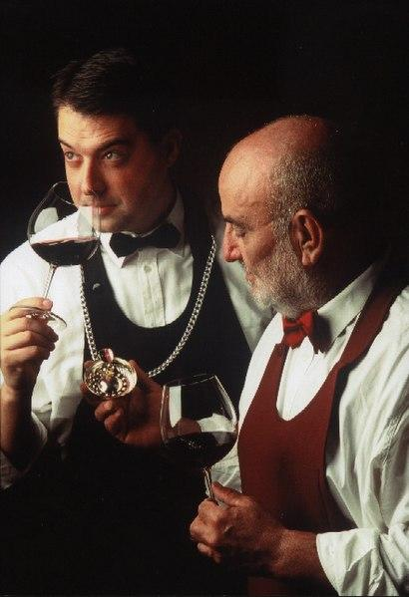
Text generation: sommelier text

Slide 28
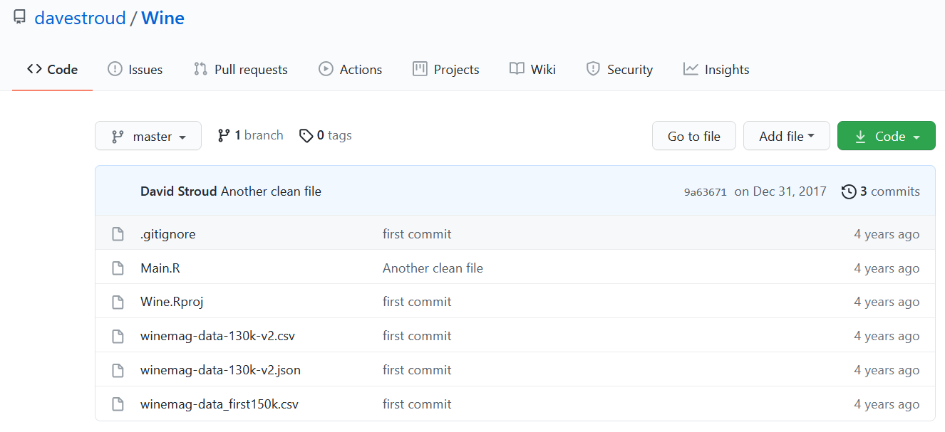
wine reviews
https://github.com/davestroud/Wine
winemag-data-130k-v2.csv

Slide 29
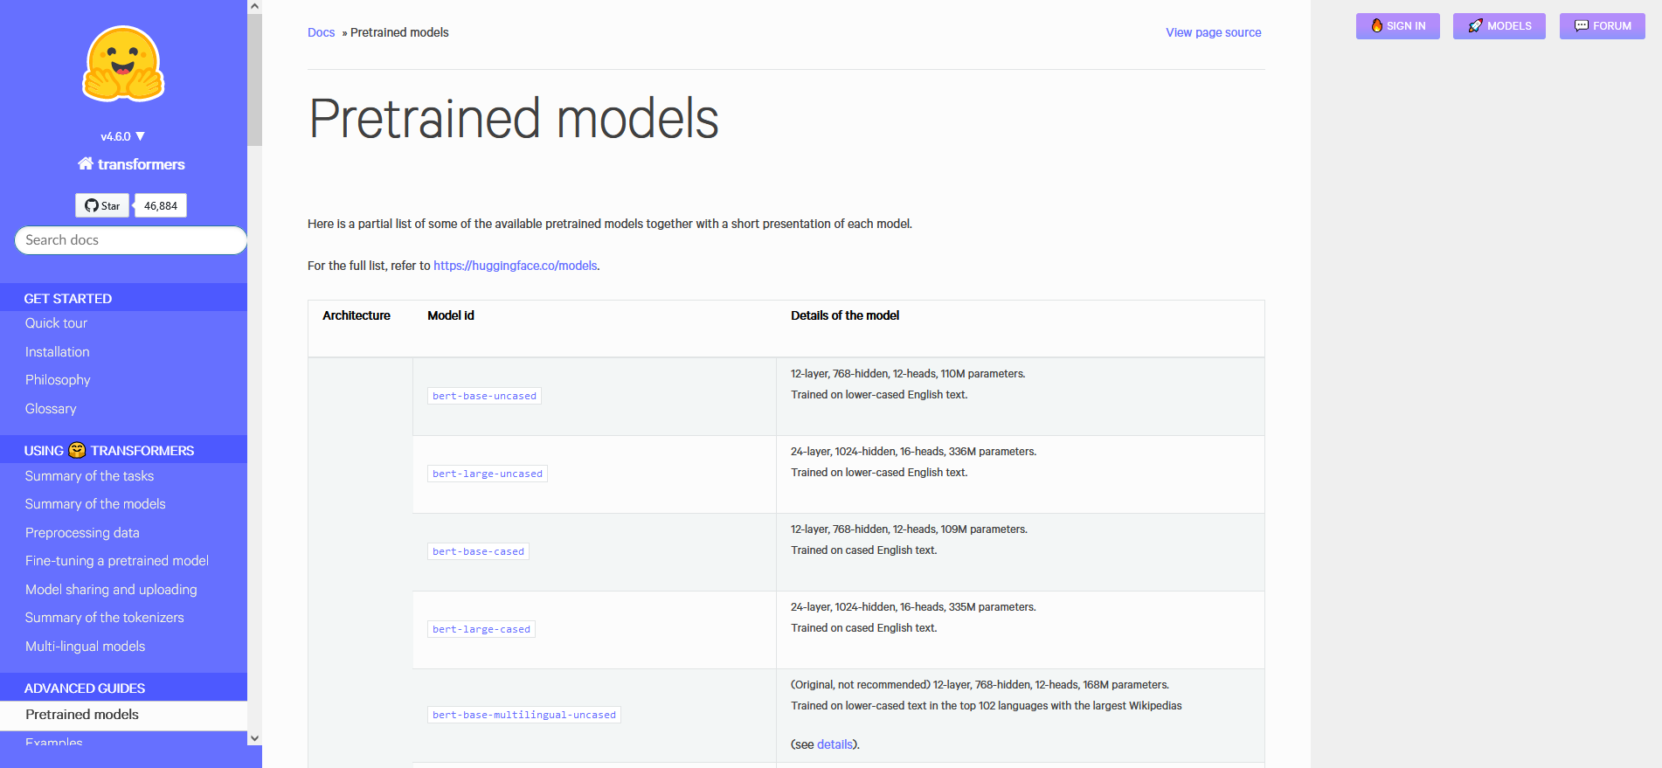
gpt-2 (Open AI)
Notes:
First I looked for pretrained models on a site that had been recommended in class.

Slide 30
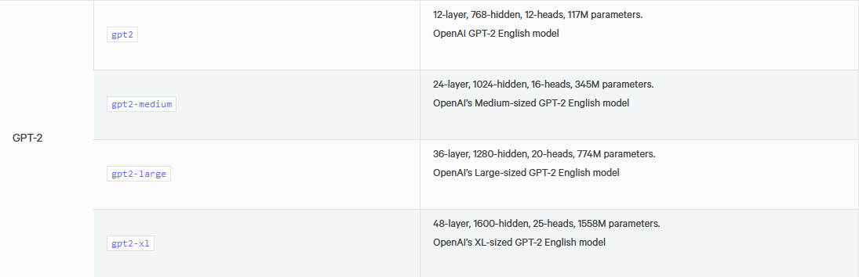
gpt-2 (Open AI)

Slide 31
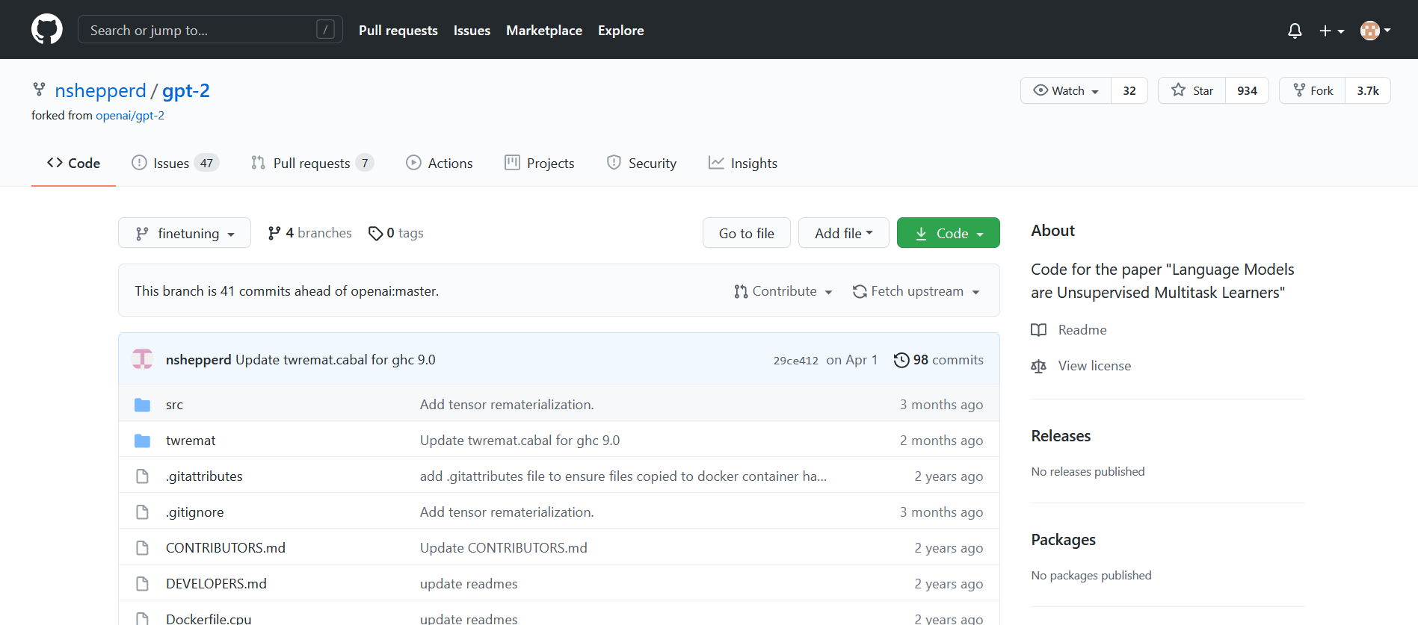
gpt-2 (Open AI)

Slide 32
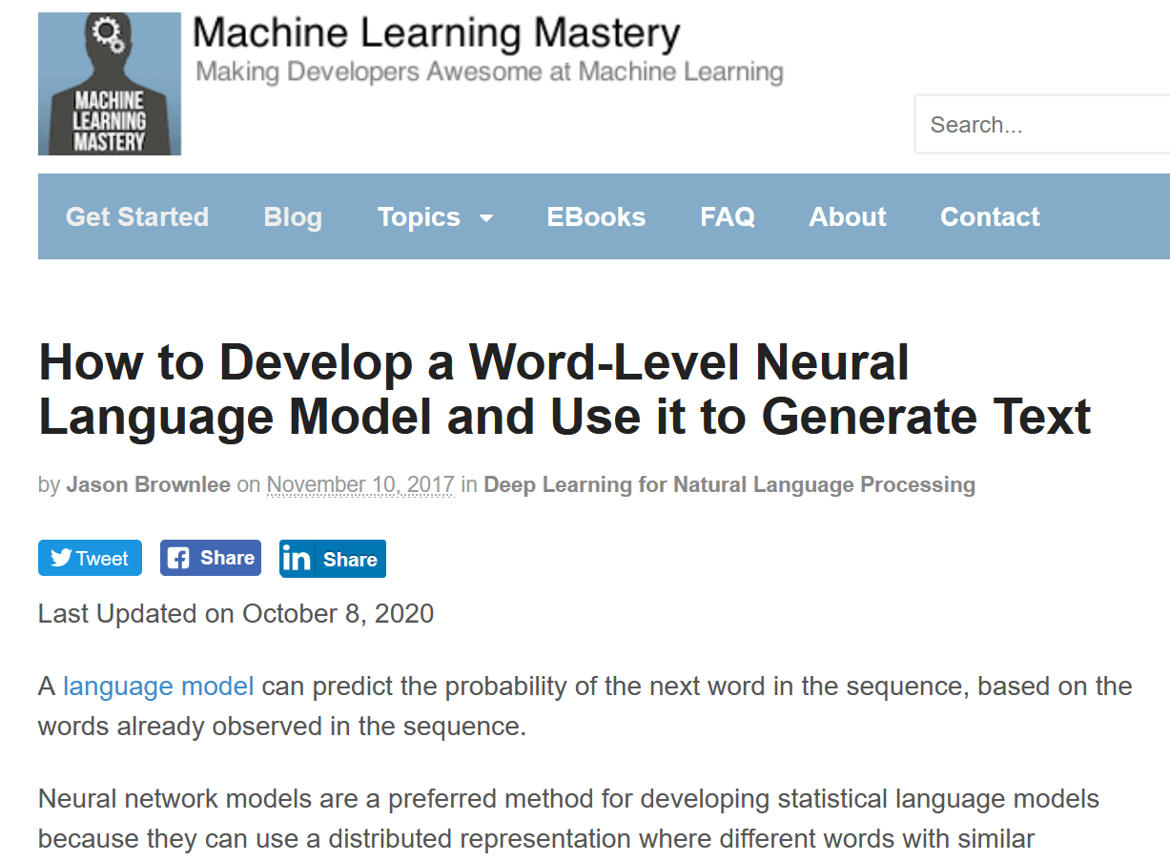
Keras

Slide 33
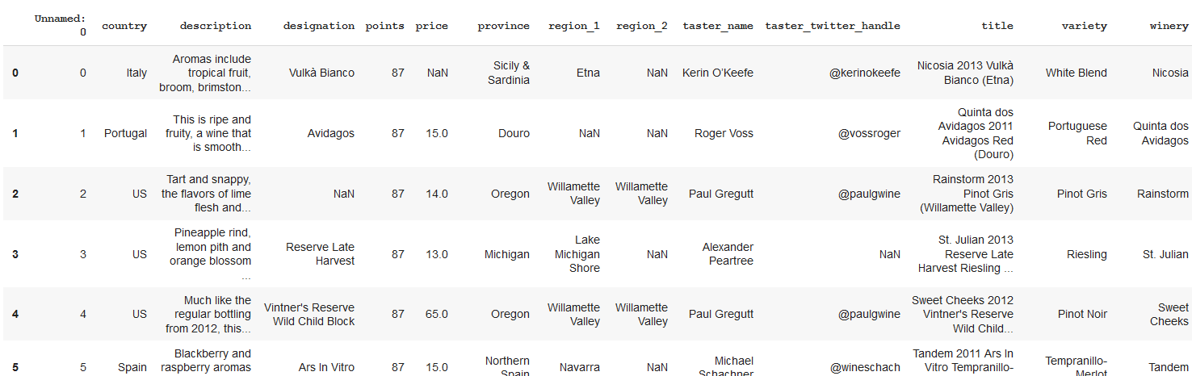
EDA
winemag data

Slide 34
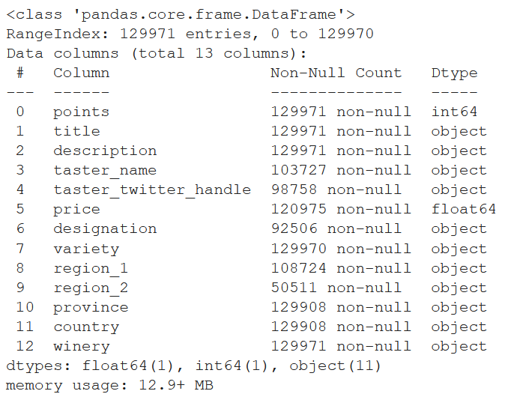
EDA
almost no null values

Slide 35
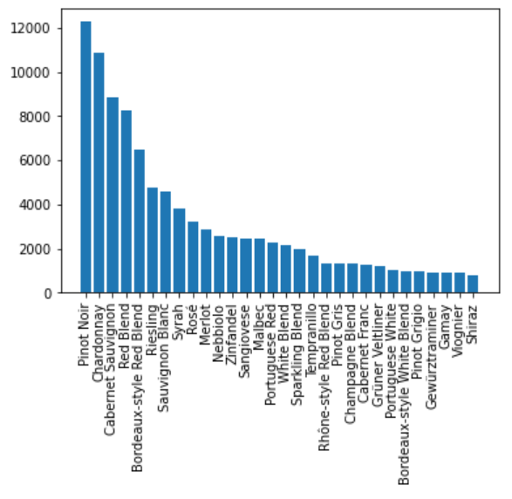
EDA
reasonably balanced

Slide 36
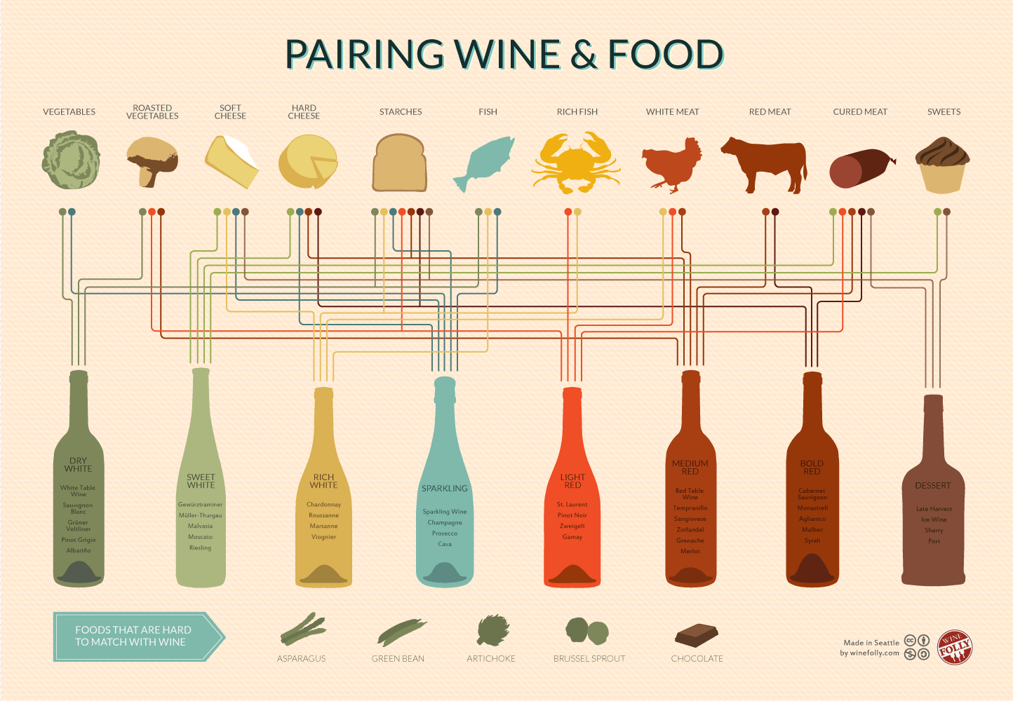
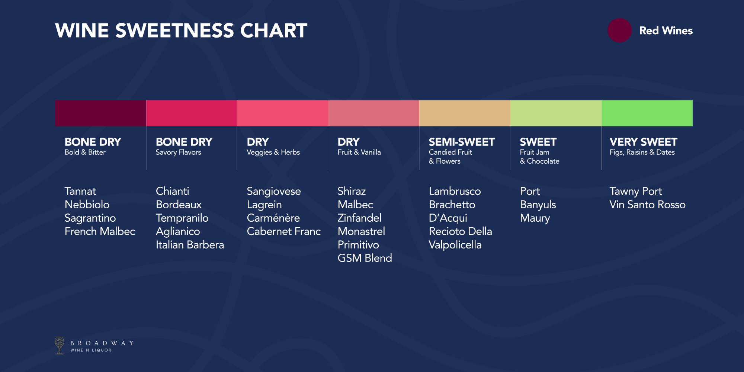
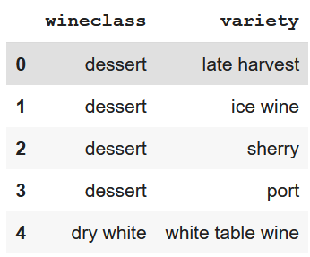
Data transformation
(hierarchy)
‘domain knowledge’

Slide 37
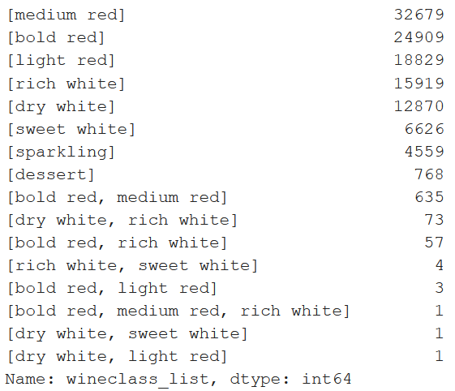
Data transformation

Slide 38
Model fine-tuning gpt-2
https://github.com/nshepperd/gpt-2/blob/finetuning/DEVELOPERS.md

Slide 39
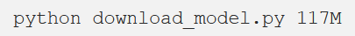
Model fine-tuning gpt-2

Slide 40
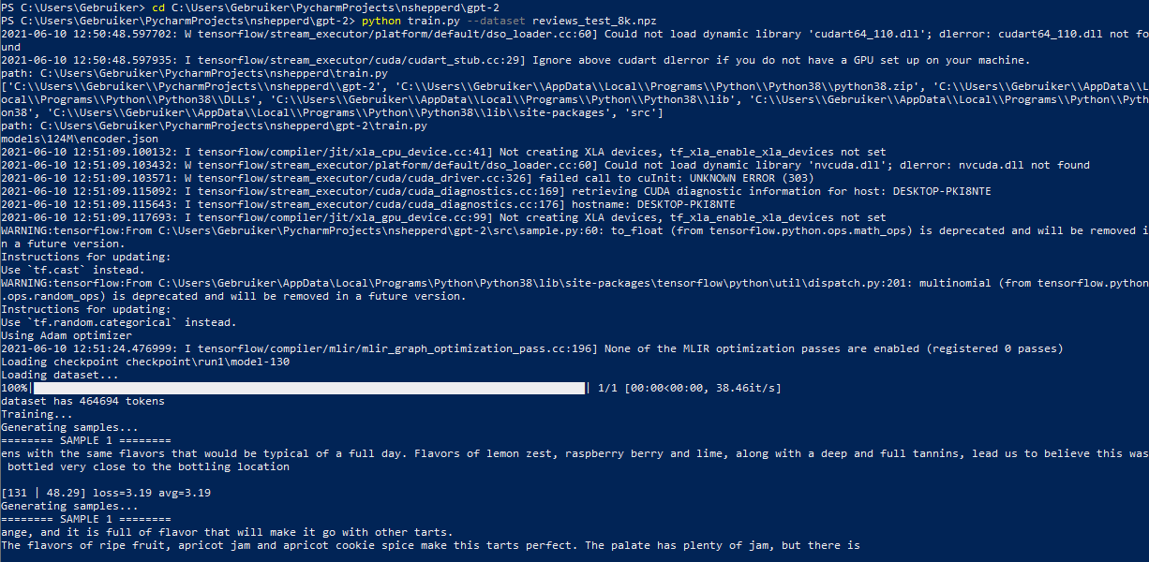
Model fine-tuning gpt-2

Slide 41
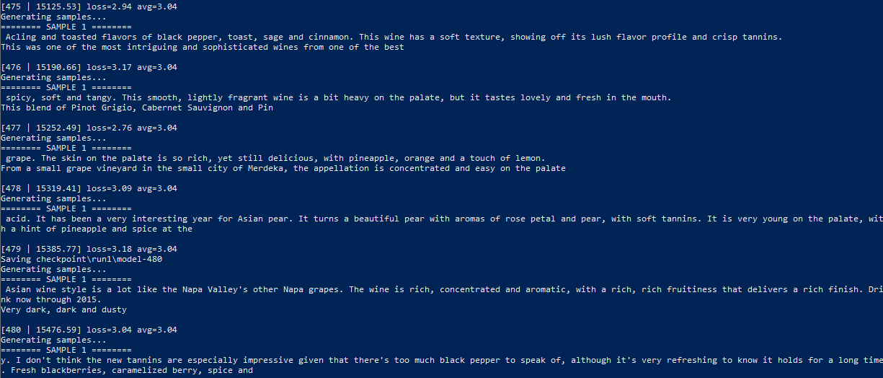

Slide 42
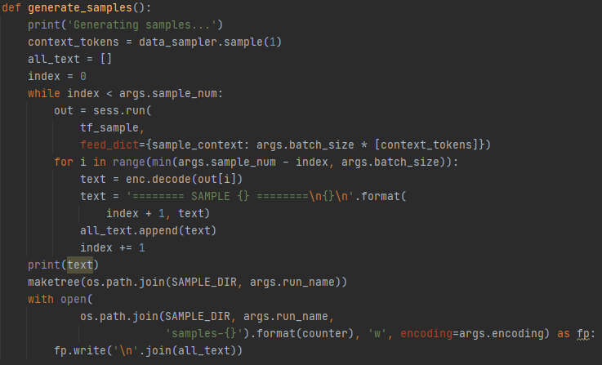
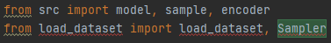
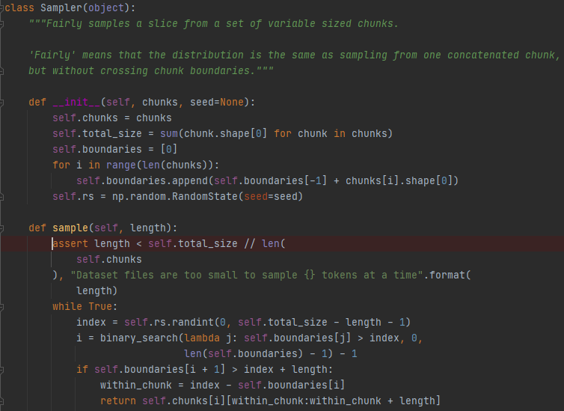
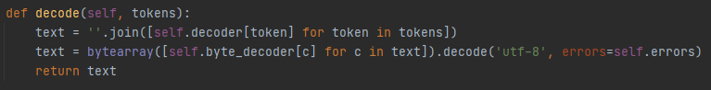

Slide 43
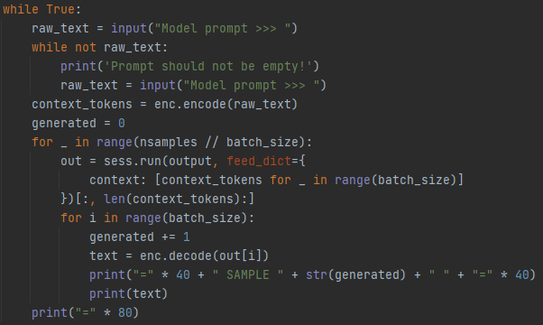

Slide 44
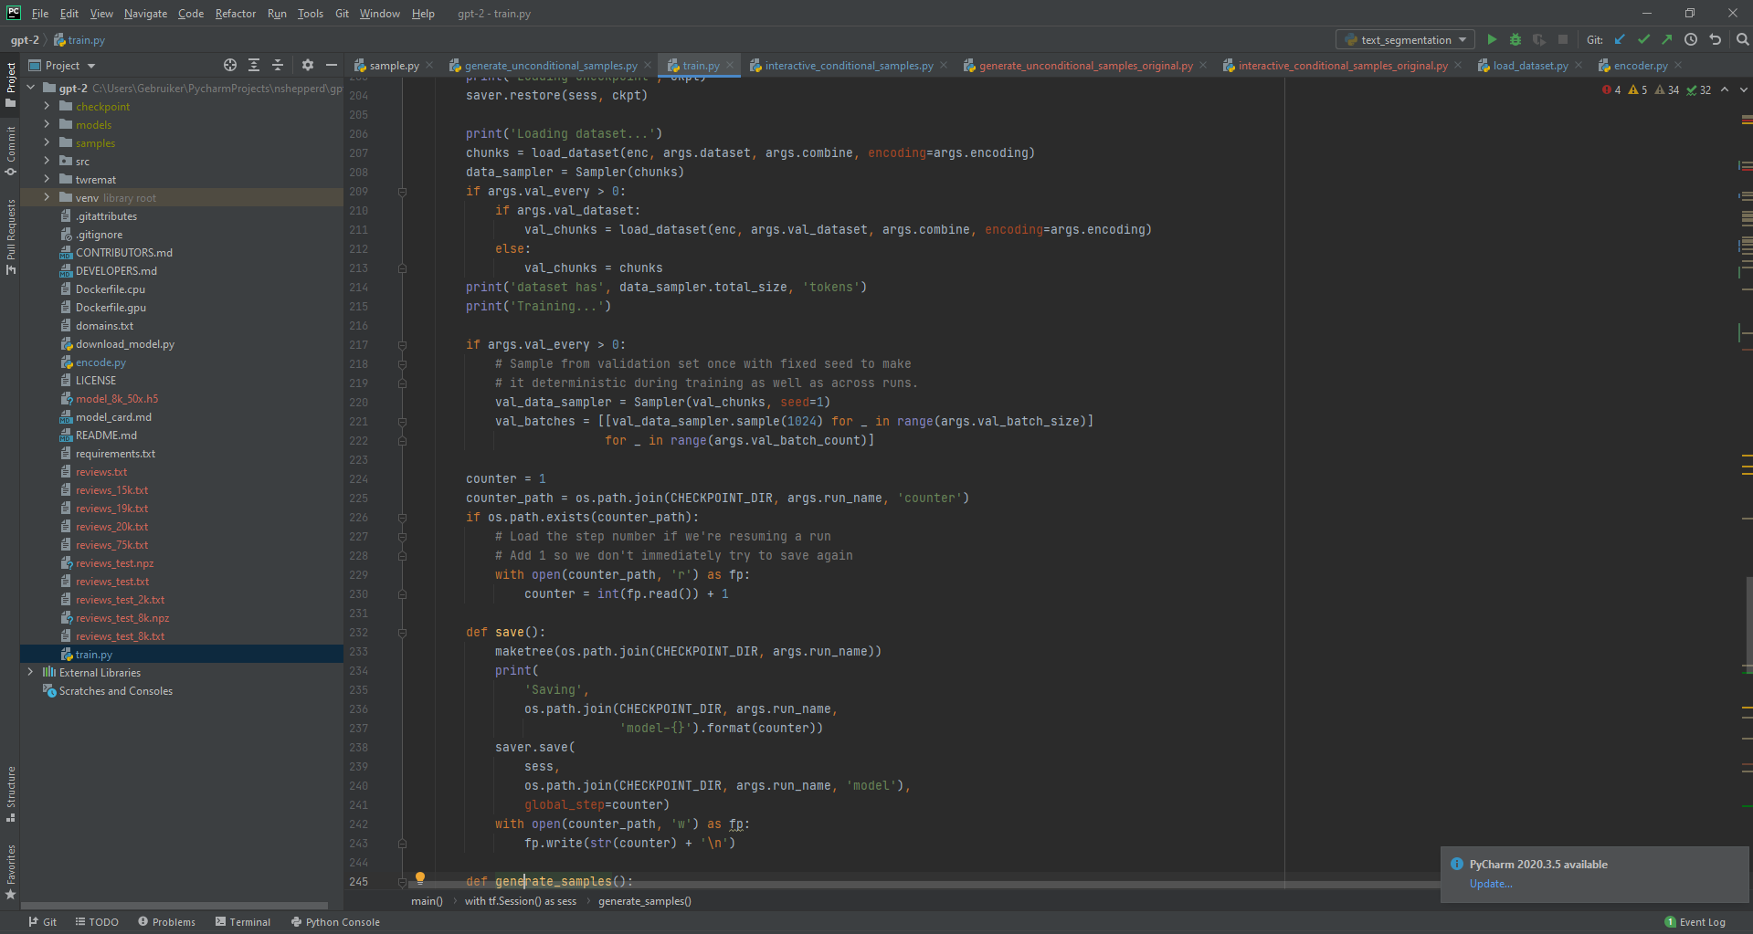

Slide 45
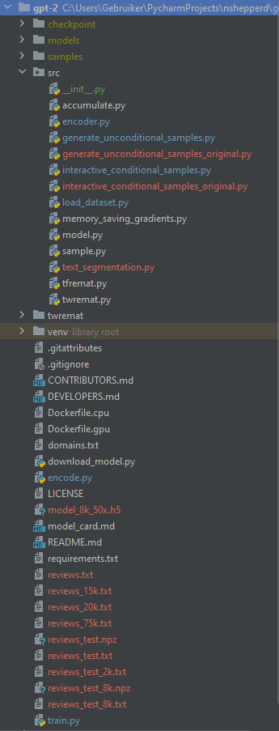

Slide 46
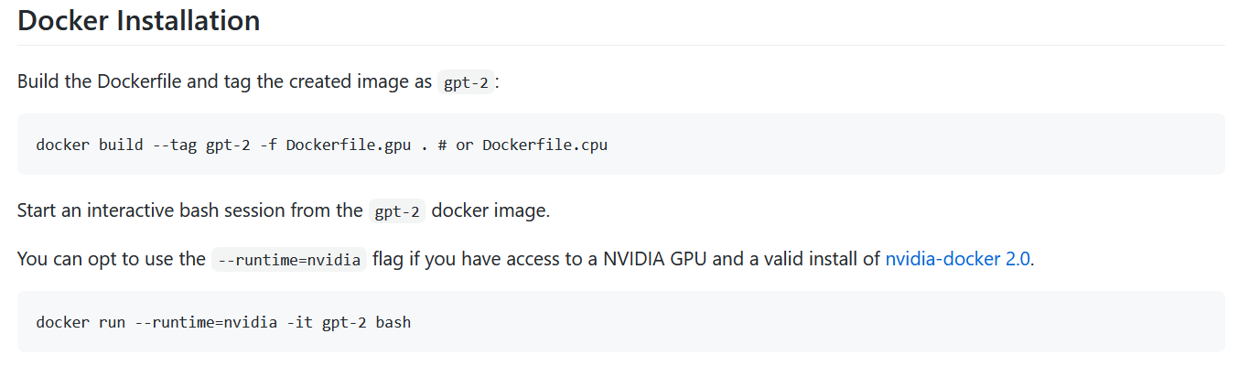

Slide 47



Keras
https://machinelearningmastery.com/how-to-develop-a-word-level-neural-language-model-in-keras/

Slide 48

Keras
8k, sampled proportionally
training

Slide 49


Keras
applying

Slide 50
Critical notes
text segmentation to have clearly separated sentences
more parameters than only seed text could improve sample ‘accuracy’

Slide 51
Web Application

Slide 52

Application
https://aisommelier.azurewebsites.net/
basic, one-page application
Detect, Pair, Present separately or all at once
flask
template: https://www.creative-tim.com/product/black-dashboard-flask
adjusted routes & templates
added backend components
atypical “fat” back-end (no webservice end-points)
minimal resource consumption
less setup
dockerized deploy (https://hub.docker.com/repository/docker/cornelka/aisommelier)
“BIG” deploy (6.14GB )
hosted on azure web apps
… but it’s not a production app
security, CI/CD, clean code, dependencies, scaling, …
all code available on github (https://github.com/cornelka/aicook)
… try it on your phone and your fridge !

Slide 53

Q&A

